Slide 1
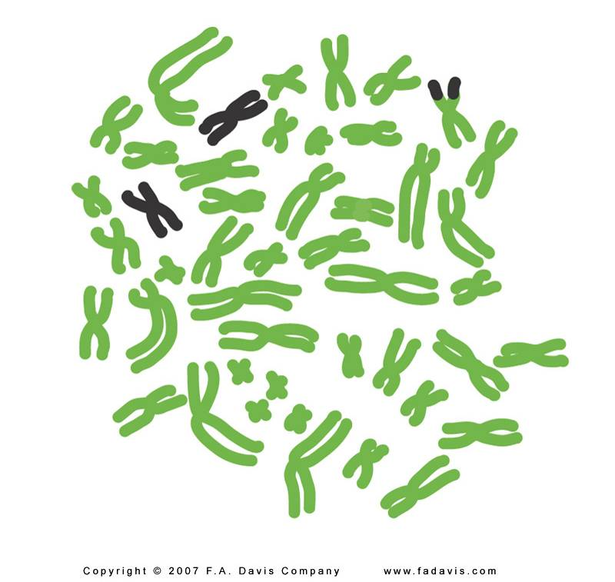
Structural Chromosomal Aberrations
DR. Neha Antal
Assistant Professor
Department of Zoology
Govt. P.G. College for Women, Gandhinagar, Jammu

Slide 2

Chromosomal aberrations are substantial changes in chromosome structure and number
    These typically affect more than one gene
    They are also called chromosomal mutations
Chromosomal aberrations or mutation is of two types
  Structural chromosomal mutation: Changes inn the gene number or gene arrangement
  Numerical chromosomal mutation: Change in the number of chromosome

Slide 3
Alterations in Chromosome Structure
There are two primary ways in which the structure of chromosomes can be altered
The total amount of genetic information in the chromosome can change
    Decrease: Deficiencies/Deletions
    Increase: Duplications & Insertions
The genetic material may remain the same, but is rearranged
    Inversions
    Translocations

Slide 4
Alterations in Chromosome Structure
Deletion
  Loss of a chromosomal segment
Duplication
  Repetition of a chromosomal segment
Inversion
A change in the direction of genetic material along a single chromosome
Translocation
  A segment of one chromosome becomes attached to a non-homologous chromosome
    Simple translocations
      One way transfer
    Reciprocal translocations
      Two way transfer

Slide 5
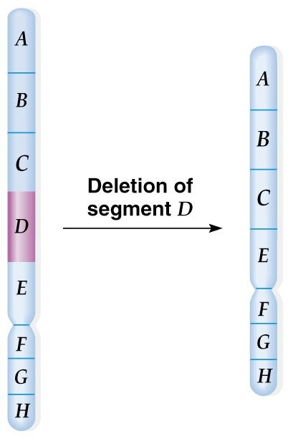
DELETION
Part of a chromosome is missing
Deletions start with chromosomal breaks induced by:
  Heat or radiation (especially ionizing).
  Viruses.
  Chemicals.
  Transposable elements.
  Errors in recombination.
Deletions do not revert, because the DNA is gone (degraded)
Types:
Terminal - involve one break
Intercalary- involve two breaks

Slide 6
DELETION
The effect of a deletion depends on what was deleted.
A deletion in one allele of a homozygous wild- type organism may give a normal phenotype While the same deletion in the wild-type allele of a heterozygote would produce a mutant phenotype.
Deletion of the centromere results in an acentric chromosome that is lost, usually with serious or lethal consequences.

Slide 7
Human disorders caused by large chromosomal deletions are generally seen in heterozygotes, since homozygotes usually die.
  The number of gene copies is important.
  Syndromes result from the loss of several to many genes.
Examples of human disorders caused by large chromosomal deletions:
  Cri-du-chat (“cry of the cat”) syndrome, resulting from deletion of part of the short arm of chromosome 5
  Cat like cry, malformation of larynx, moon face, micrognathia, microcephally, low set ears, mental retardation.

Slide 8
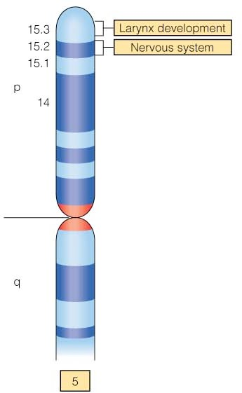
Cri du chat Syndrome
Variation in phenotype
associated with region deleted has been observed
Researchers have identified regions with genes involved in larynx and nervous system development
Pseudo-dominance: In the presence of deletion, sometimes a recessive allele of the normal homologous chromosome will behave like a dominant allele i.e. it will phenotypically express itself.

Slide 9
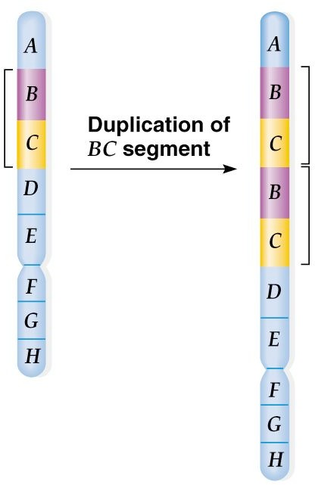
Duplication
Duplications result from doubling of chromosomal segments
Presence of a part of a chromosome in excess of the normal complement

Slide 10
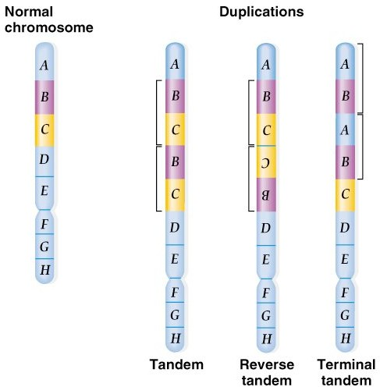
Duplication
Tandem duplications are adjacent to each other.
Reverse tandem duplications result in genes arranged in the opposite order of the original.
Tandem duplication at the end of a chromosome is a terminal tandem duplication

Slide 11
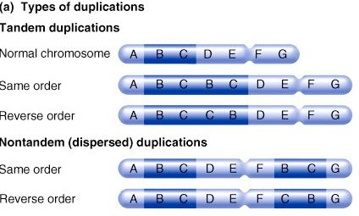
Duplication
Displaced duplication duplicated region is not situated adjacent to the original.
Transposed duplication duplicated part arrange to a non homologous chromosome

Slide 12
Duplication
An example is the Drosophila eye shape allele, Bar, that reduces the number of eye facets, giving the eye a slit-like rather than oval appearance.
Cytological examination of chromosomes showed that the Bar allele results from duplication of a small segment (16A) of the X chromosome.

Slide 13
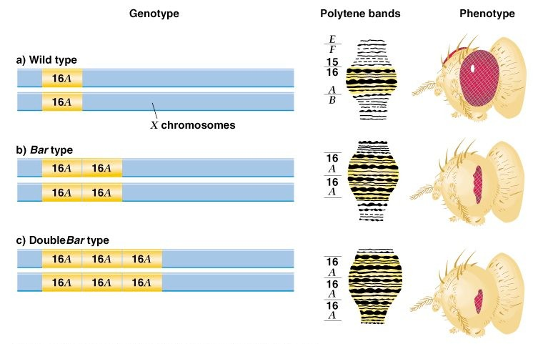

Slide 14
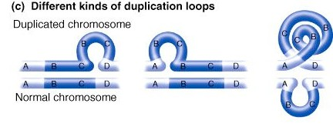
Duplication loops form when chromosomes pair in duplication heterozygotes
In prophase I, the duplication loop can assume different configurations that maximize the pairing of related regions

Slide 15
Position Effect
Due to change in the position of a gene or a gene group in relation to other genes in a chromosome, phenotype of organism is altered, this effect is called position effect.
It also represents a source of genetic variation.

Slide 16
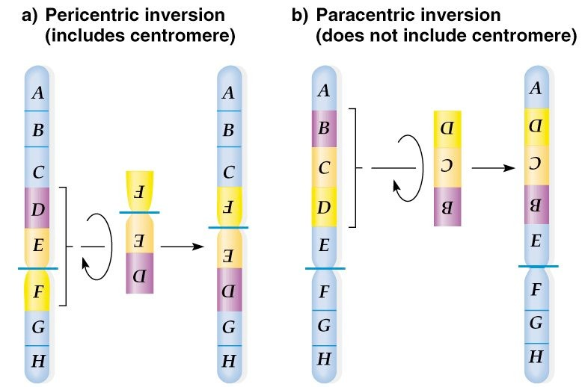
Inversion
Rotation of a part of a chromosome or a set of genes by 180º on its own axis.

Slide 17
Inversion
The meiotic consequence depends on whether the inversion occurs in a homozygote or a heterozygote.
A homozygote will have normal meiosis.
The effect in a heterozygote depends on whether crossing-over occurs.
If there is no crossing-over, no meiotic problems occur.
If crossing-over occurs in the inversion, unequal crossover may produce serious genetic consequences.

Slide 18
Inversion
Heterozygous Pericentric Inversion:
  One normal gamete
  One gamete with inversion
  One gamete with a duplication and deletion.
  One gamete with reciprocal duplication and deletion.
Heterozygous Paracentric Inversion:
  One normal gamete
  One gamete with inversion
  Two deletion products
  Some material lost.

Slide 19
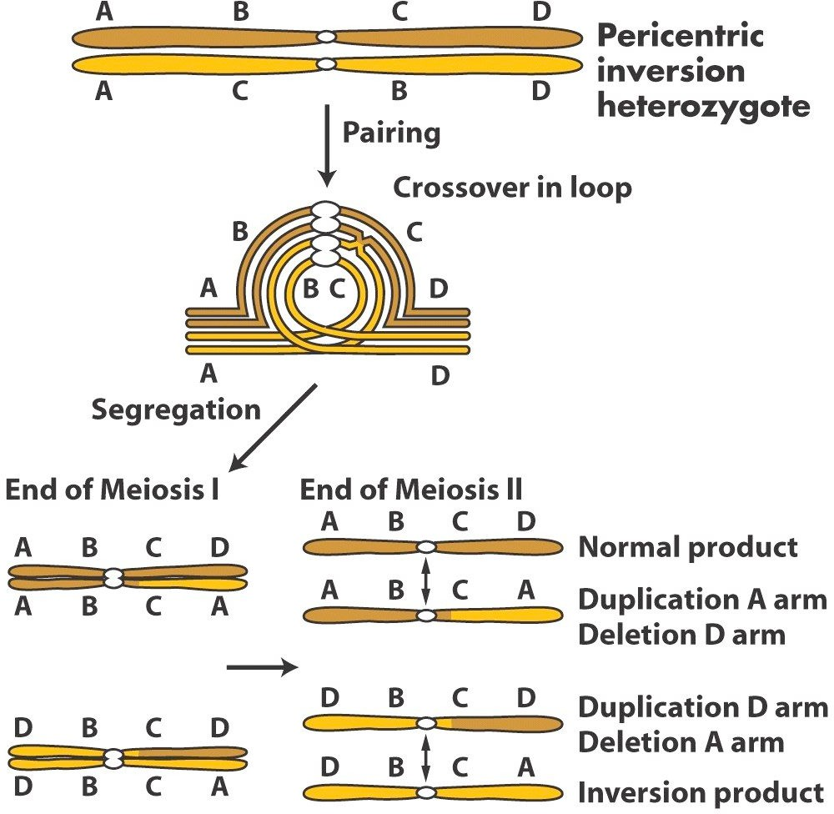
Crossing over in Pericentric Inversion

Slide 20
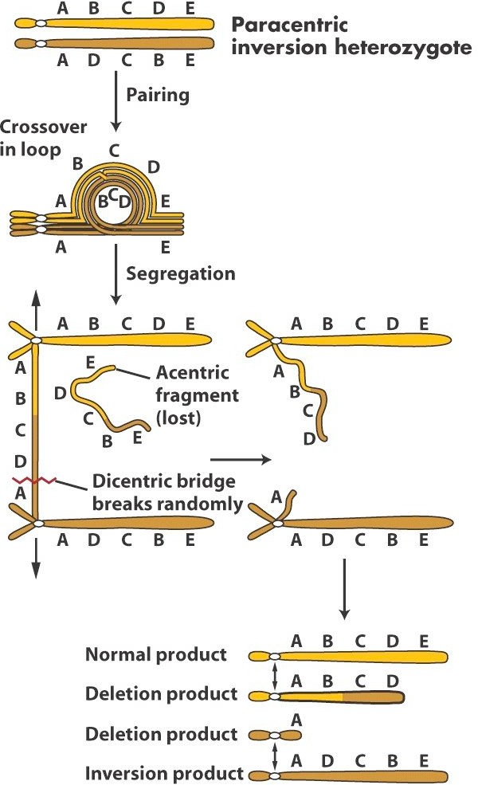
Crossing over in Paracentric Inversion

Slide 21
In an inversion, the total amount of genetic information stays the same
  Therefore, the great majority of inversions have no phenotypic consequences
In rare cases, inversions can alter the phenotype of an individual
  Break point effect
    The breaks leading to the inversion occur in a vital gene
  Position effect
    A gene is repositioned in a way that alters its gene expression
About 2% of the human population carries inversions that are detectable with a light microscope
  Most of these individuals are phenotypically normal
  However, a few produce offspring with genetic abnormalities

Slide 22
Translocation
A chromosomal translocation occurs when a segment of one chromosome becomes attached to another.
There are two main types of medically important translocations:
Reciprocal (balanced) Translocations
Robertsonian (unbalanced) Translocations
Both types of translocations are capable of causing disease in humans
.

Slide 23
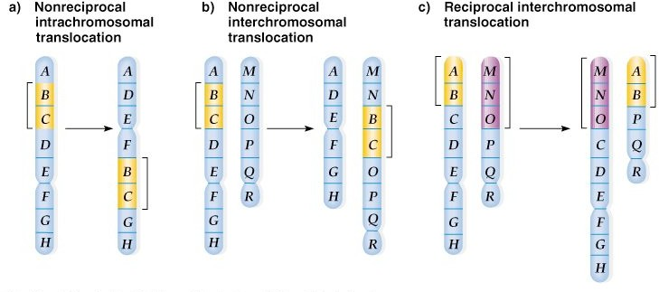
.

Slide 24
Reciprocal Translocations
In reciprocal translocations two non-homologous chromosomes exchange genetic material
Reciprocal translocations lead to a rearrangement of the genetic material
  not a change in the total amount
  Thus, they are also called balanced translocations.
.

Slide 25
Robertsonian Translocations
In Robertsonian Translocations the transfer of genetic material occurs in only one direction
Robertsonian translocations are associated with phenotypic abnormalities or even lethality.
Example: Familial Down Syndrome
  In this condition, the majority of chromosome 21 is attached to chromosome 14.
  The individual would have three copies of genes found on a large segment of chromosome 21
Therefore, they exhibit the characteristics of Down syndrome
.

Slide 26
This translocation occurs as follows:
  Breaks occur at the extreme ends of the short arms of two non-homologous acrocentric chromosomes
  The larger fragments fuse at their centromeic regions to form a single chromosome
  The small acrocentric fragments are subsequently lost.
  This type of translocation is the most common type of chromosomal rearrangement in humans.
Robertsonian translocations are confined to chromosomes 13, 14, 15, 21
The acrocentric chromosomes
.

Slide 27
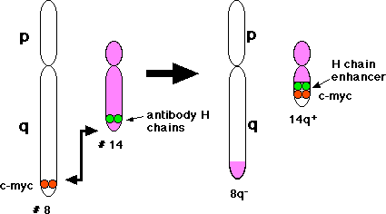
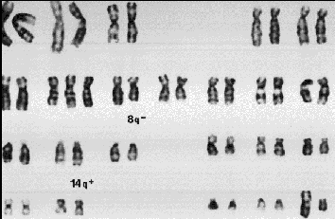
Burkitt’s lymphoma
An aggressive (fast-growing) type of B-cell non-Hodgkin lymphoma that occurs most often in children and young adults. The disease may affect the jaw, central nervous system, bowel, kidneys, ovaries, or other organs.

Slide 28

Thank You

